Slide 1



Project Selection-Financial Criteria
LECTURE # 11

Slide 2
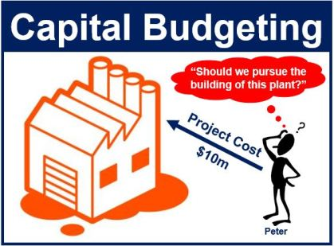
Capital Budgeting
Capital budgeting is the whole process of analyzing projects and deciding which ones to accept.

Slide 3
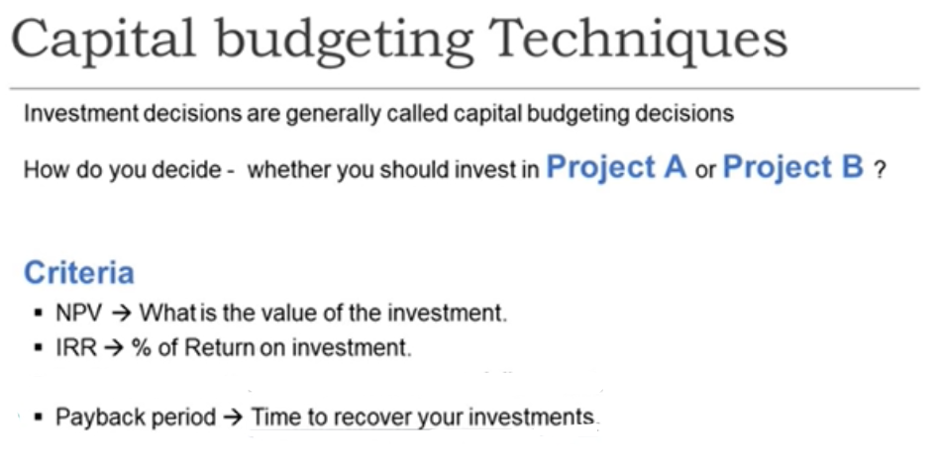

Slide 4

OPPORTUNITY COST

Slide 5
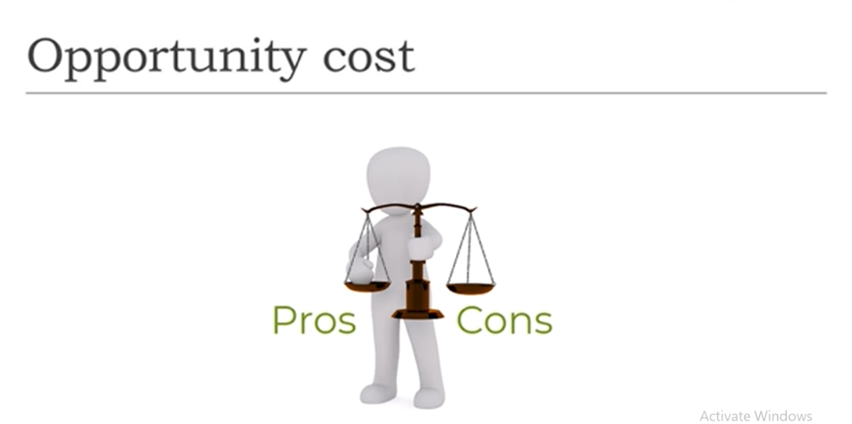
OPPORTUNITY COST
Opportunity Cost is the cost or price of the next best alternative that is available to the business that has foregone to acquire something else.

Slide 6
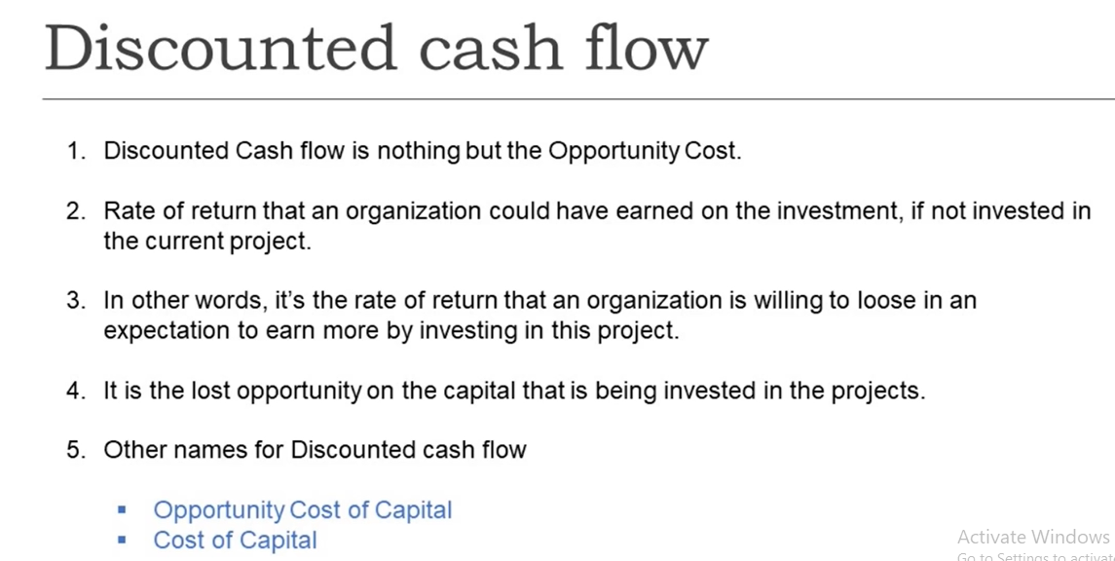
DISCOUNTED CASH FLOWS

Slide 7
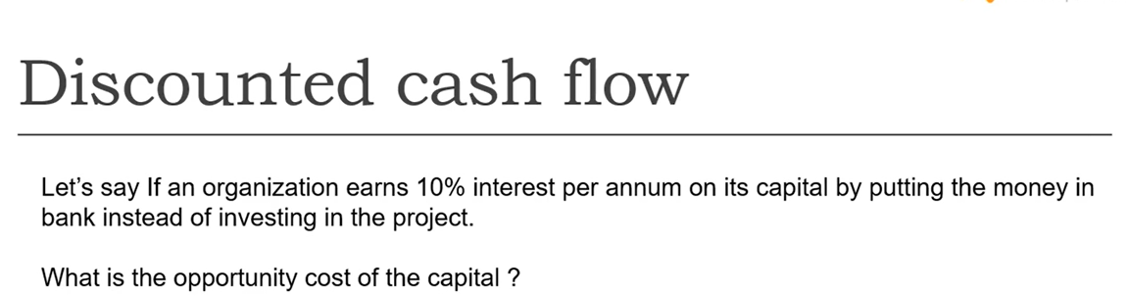
EXAMPLE DISCOUNTED CASH FLOW

Slide 8
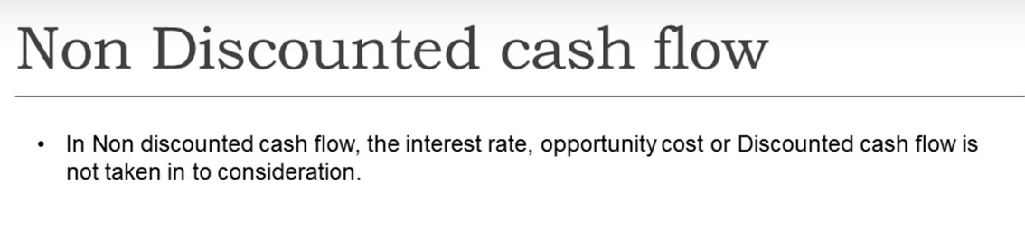
NON DISCOUNTED CASH FLOW

Slide 9
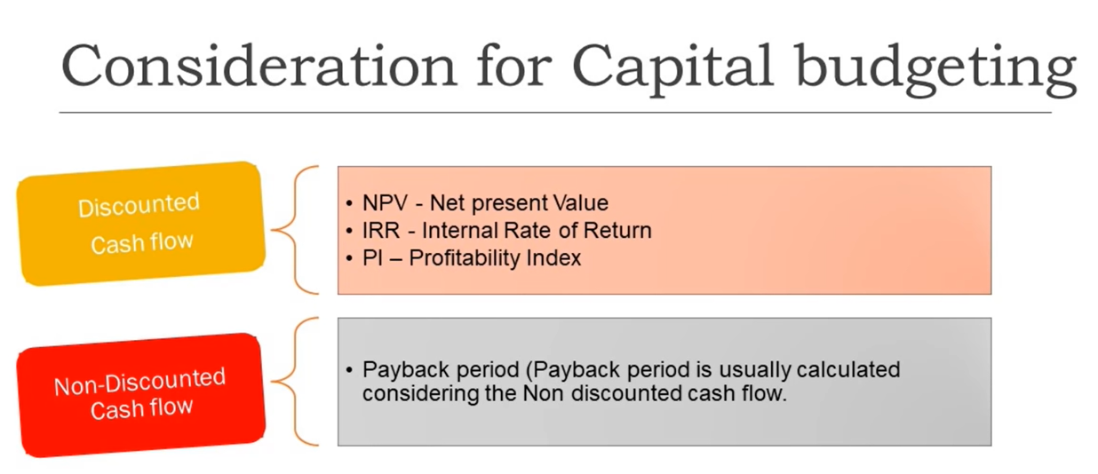
CONSIDERATION
FOR
CAPITAL BUDGETING

Slide 10

TIME VALUE OF MONEY

Slide 11
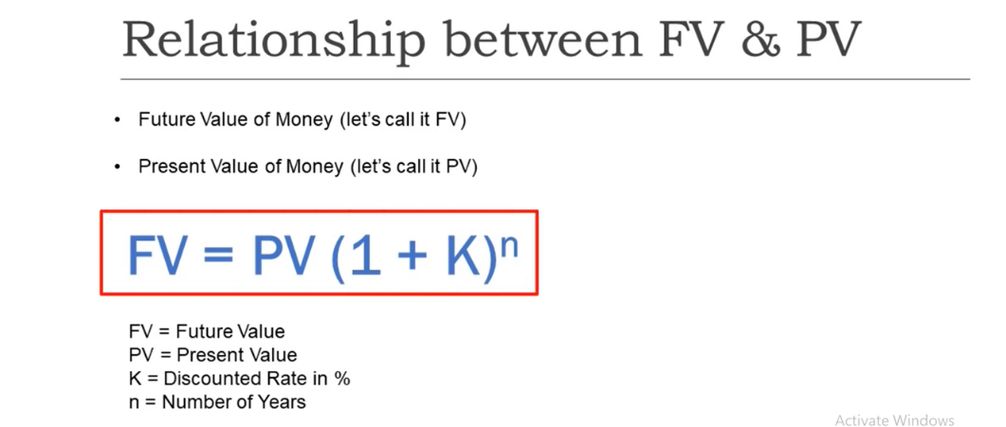
FORMULA

Slide 12

FORMULA

Slide 13
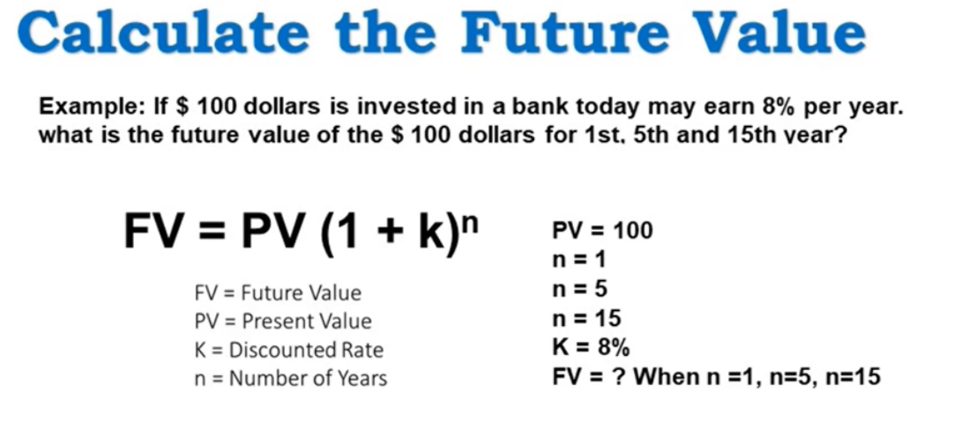

Slide 14
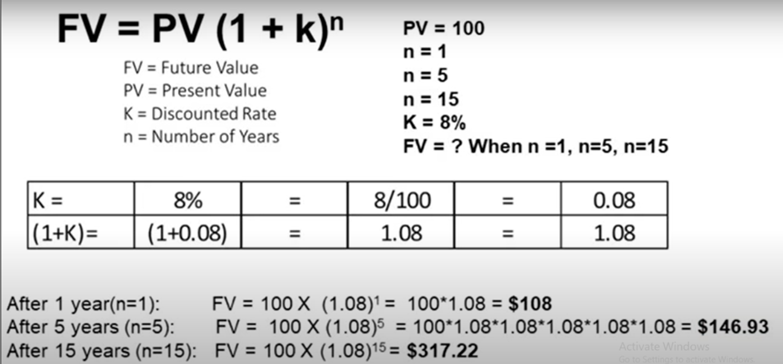

Slide 15
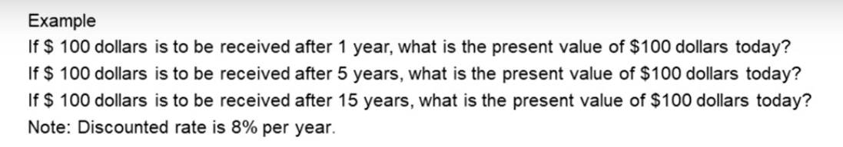
EXERCISE

Slide 16
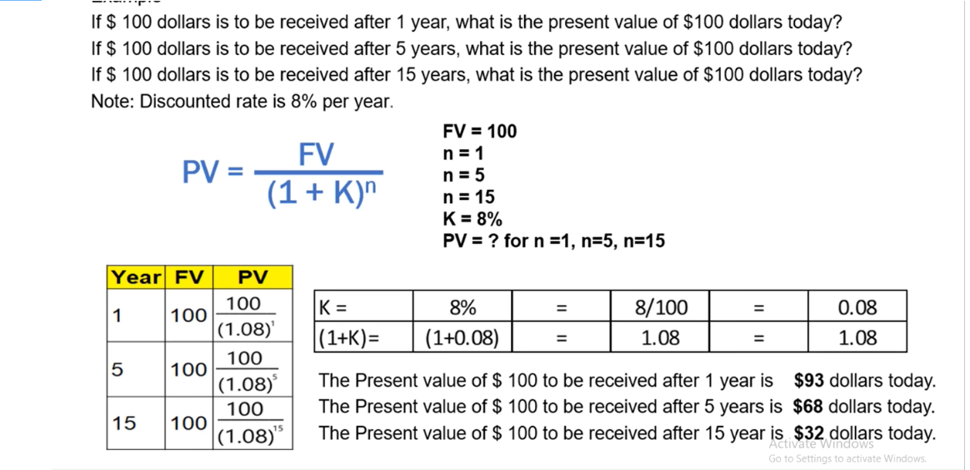

Slide 17
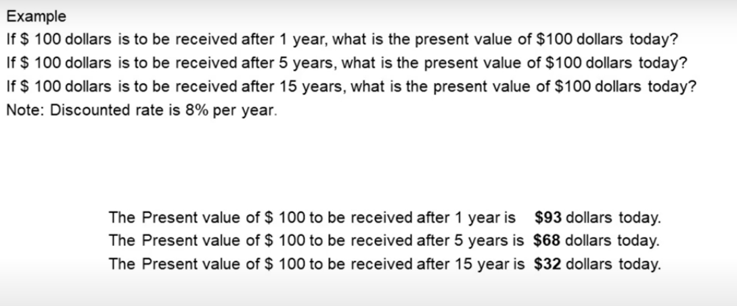

Slide 18
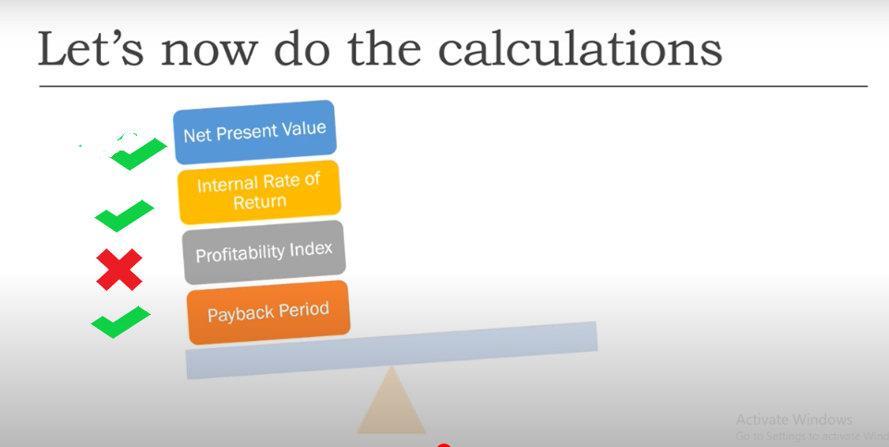

Slide 19
Net Present Value (NPV)
The net present value (NPV), defined as the present value of a project’s cash inflows minus the present value of its costs, tells us how much the project contributes to shareholder wealth.

Slide 20
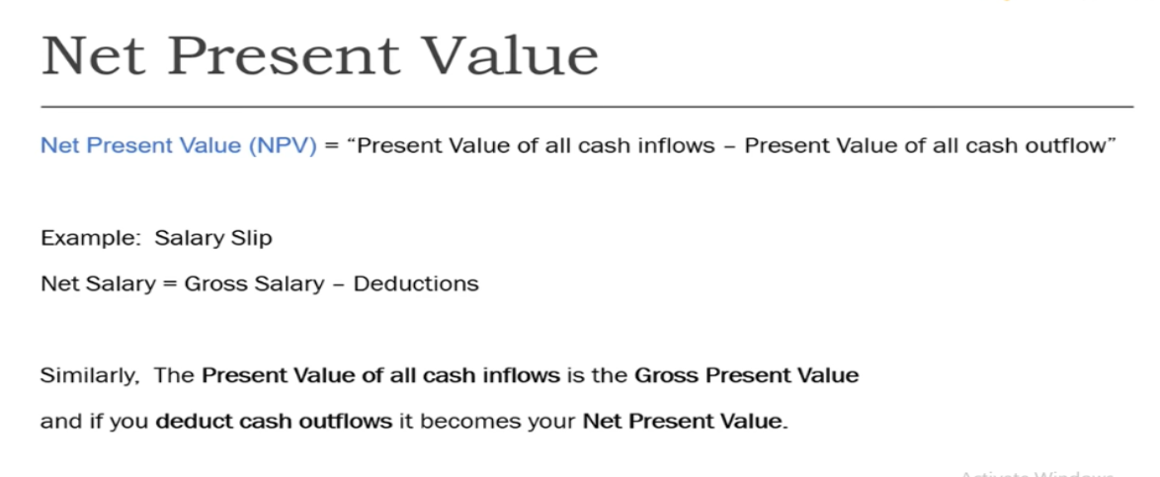

Slide 21
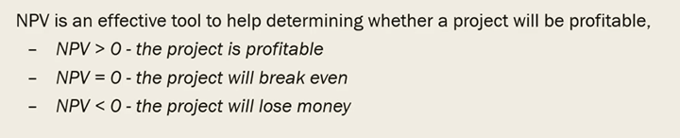
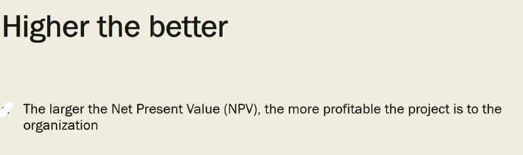

Slide 22
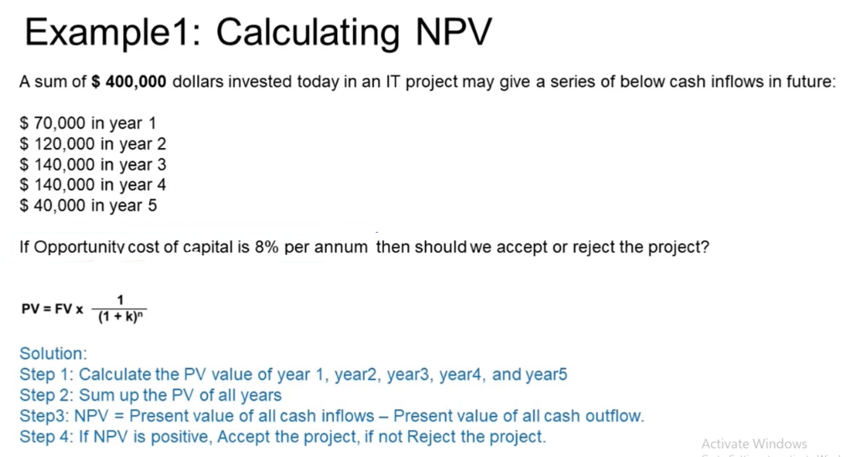

Slide 23
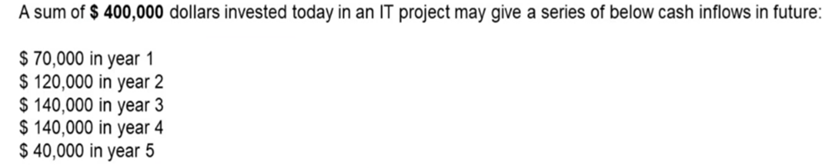
Cost of Opportunity =8%

Slide 24
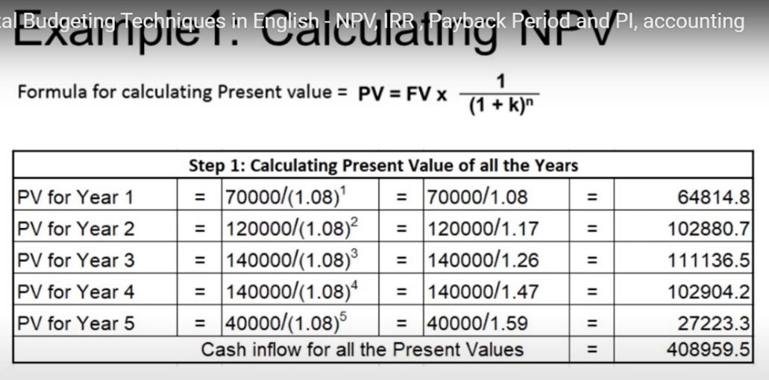

Slide 25
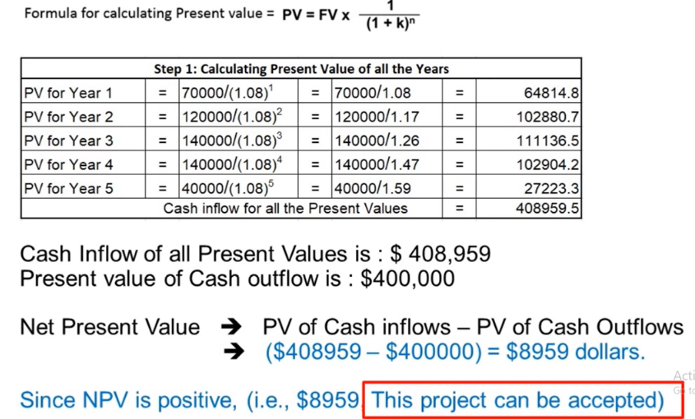

Slide 26
EXERCISE 2
Change the interest rate to 15 %

Slide 27
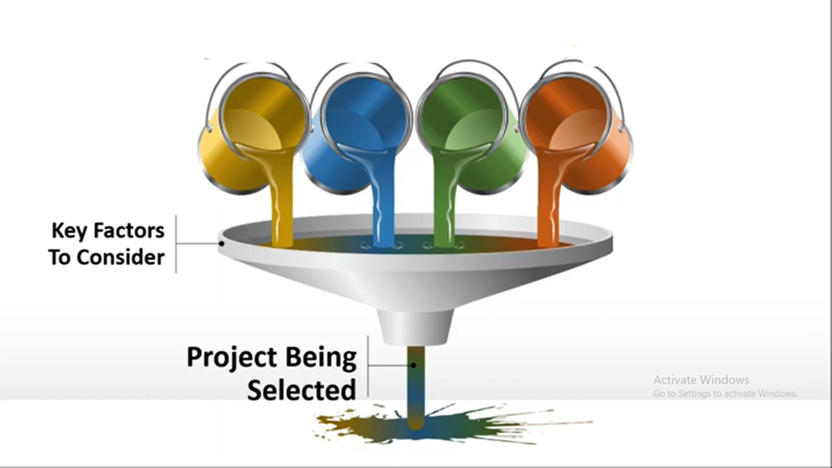
KEY FACTORS TO CONSIDER
TO SELECT PROJECT

Slide 28
INDEPENDENT
VS
MUTUALLY EXCLUSIVE PROJECTS
Independent projects are those whose cash flows are not affected by other projects.
Example: If Wal-Mart were considering a new store in Boise and another in Atlanta, those projects would be independent.
Mutually exclusive projects, on the other hand, are two different ways of accomplishing the same result, so if one project is accepted then the other must be rejected.
Example: A conveyor-belt system to move goods in a warehouse and a fleet of forklifts for the same purpose would be mutually exclusive—accepting one implies rejecting the other.

Slide 29
NPV Decision Rules
Independent projects: If NPV exceeds zero, accept the project. If both have positive NPVs, accept them both if they are independent.
Mutually exclusive projects: Accept the project with the highest positive NPV. If no project has a positive NPV, then reject them all. If the projects are mutually exclusive, the NPV criterion would select the project with higher NPV.

Slide 30
IRR-Internal Rate of Return
The internal rate of return is a metric used in financial analysis to estimate the profitability of potential investments.
Internal rate of return (IRR) is the annual rate of growth an investment is expected to generate.
A project’s IRR is the discount rate that makes the PV of the inflows to equal the initial cost.
The internal rate of return is a discount rate that makes the net present value (NPV) of all cash flows equal to zero.

Slide 31
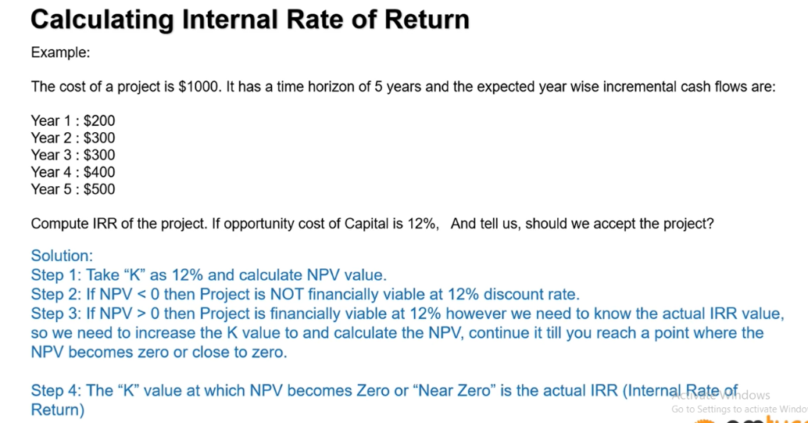

Slide 32
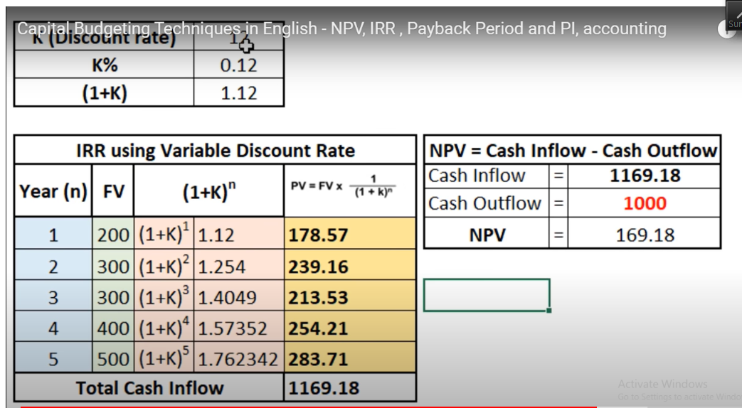

Slide 33
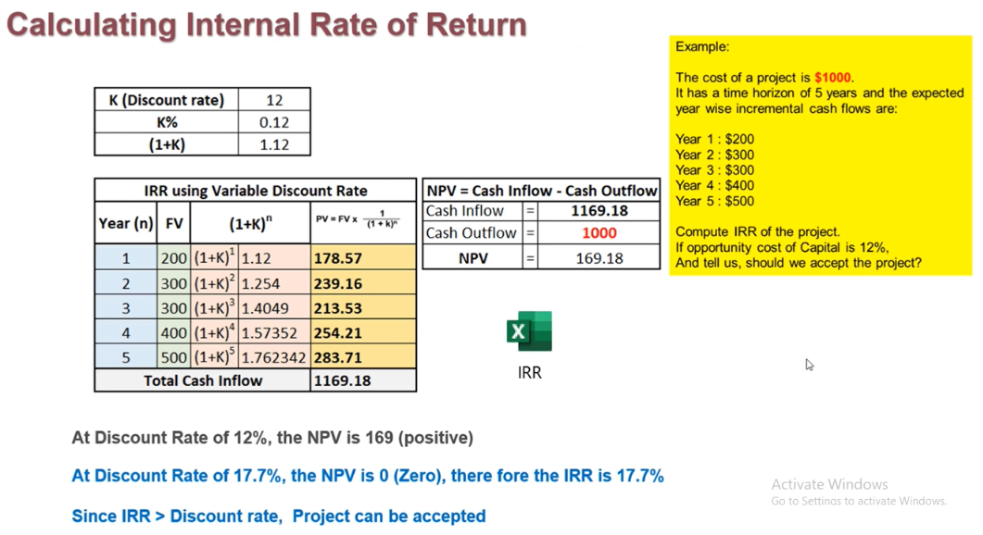

Slide 34
IRR Decision Rules
Independent projects: If IRR exceeds the project’s Cost of Capital, then the project should be accepted.
If IRR is less than the project’s Cost of Capital, reject it.
Mutually exclusive projects. Accept the mutually exclusive project with the highest IRR, provided that the project’s IRR is greater than its Cost of Capital. Reject project whose IRR does not exceed the firm’s Cost of Capital

Slide 35
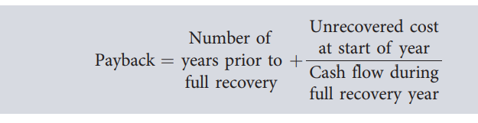
PAY BACK PERIOD
Payback period, defined as the number of years required to recover the funds invested in a project from its operating cash flows.

Slide 36
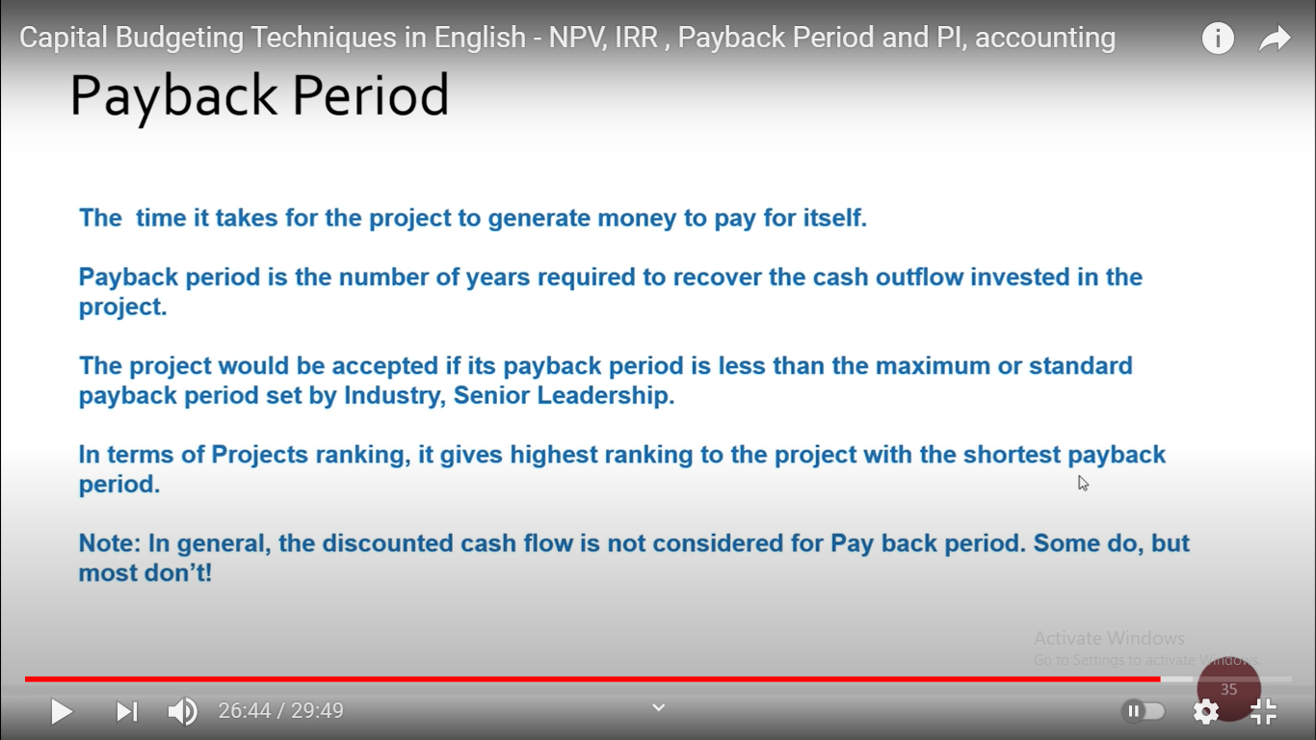

Slide 37
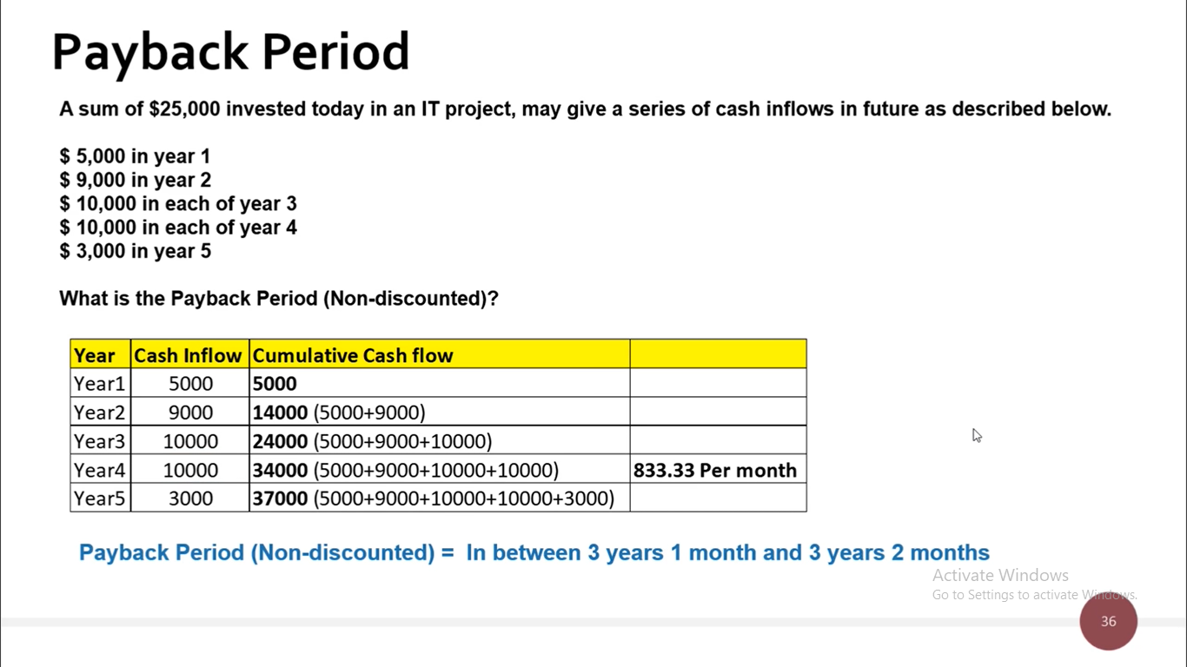
EXAMPLE
10000/12

Slide 38
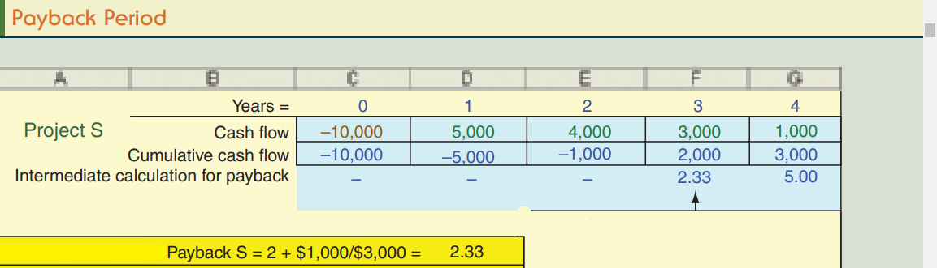

Slide 39
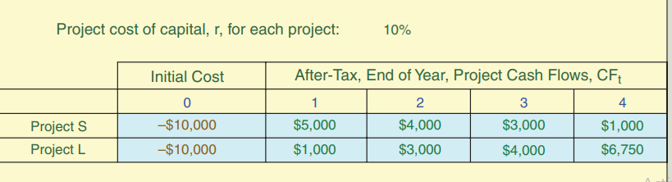
EXAMPLE

Slide 40
